Slide 1
Problem Determination and Troubleshooting — <presenter name>

Slide 2


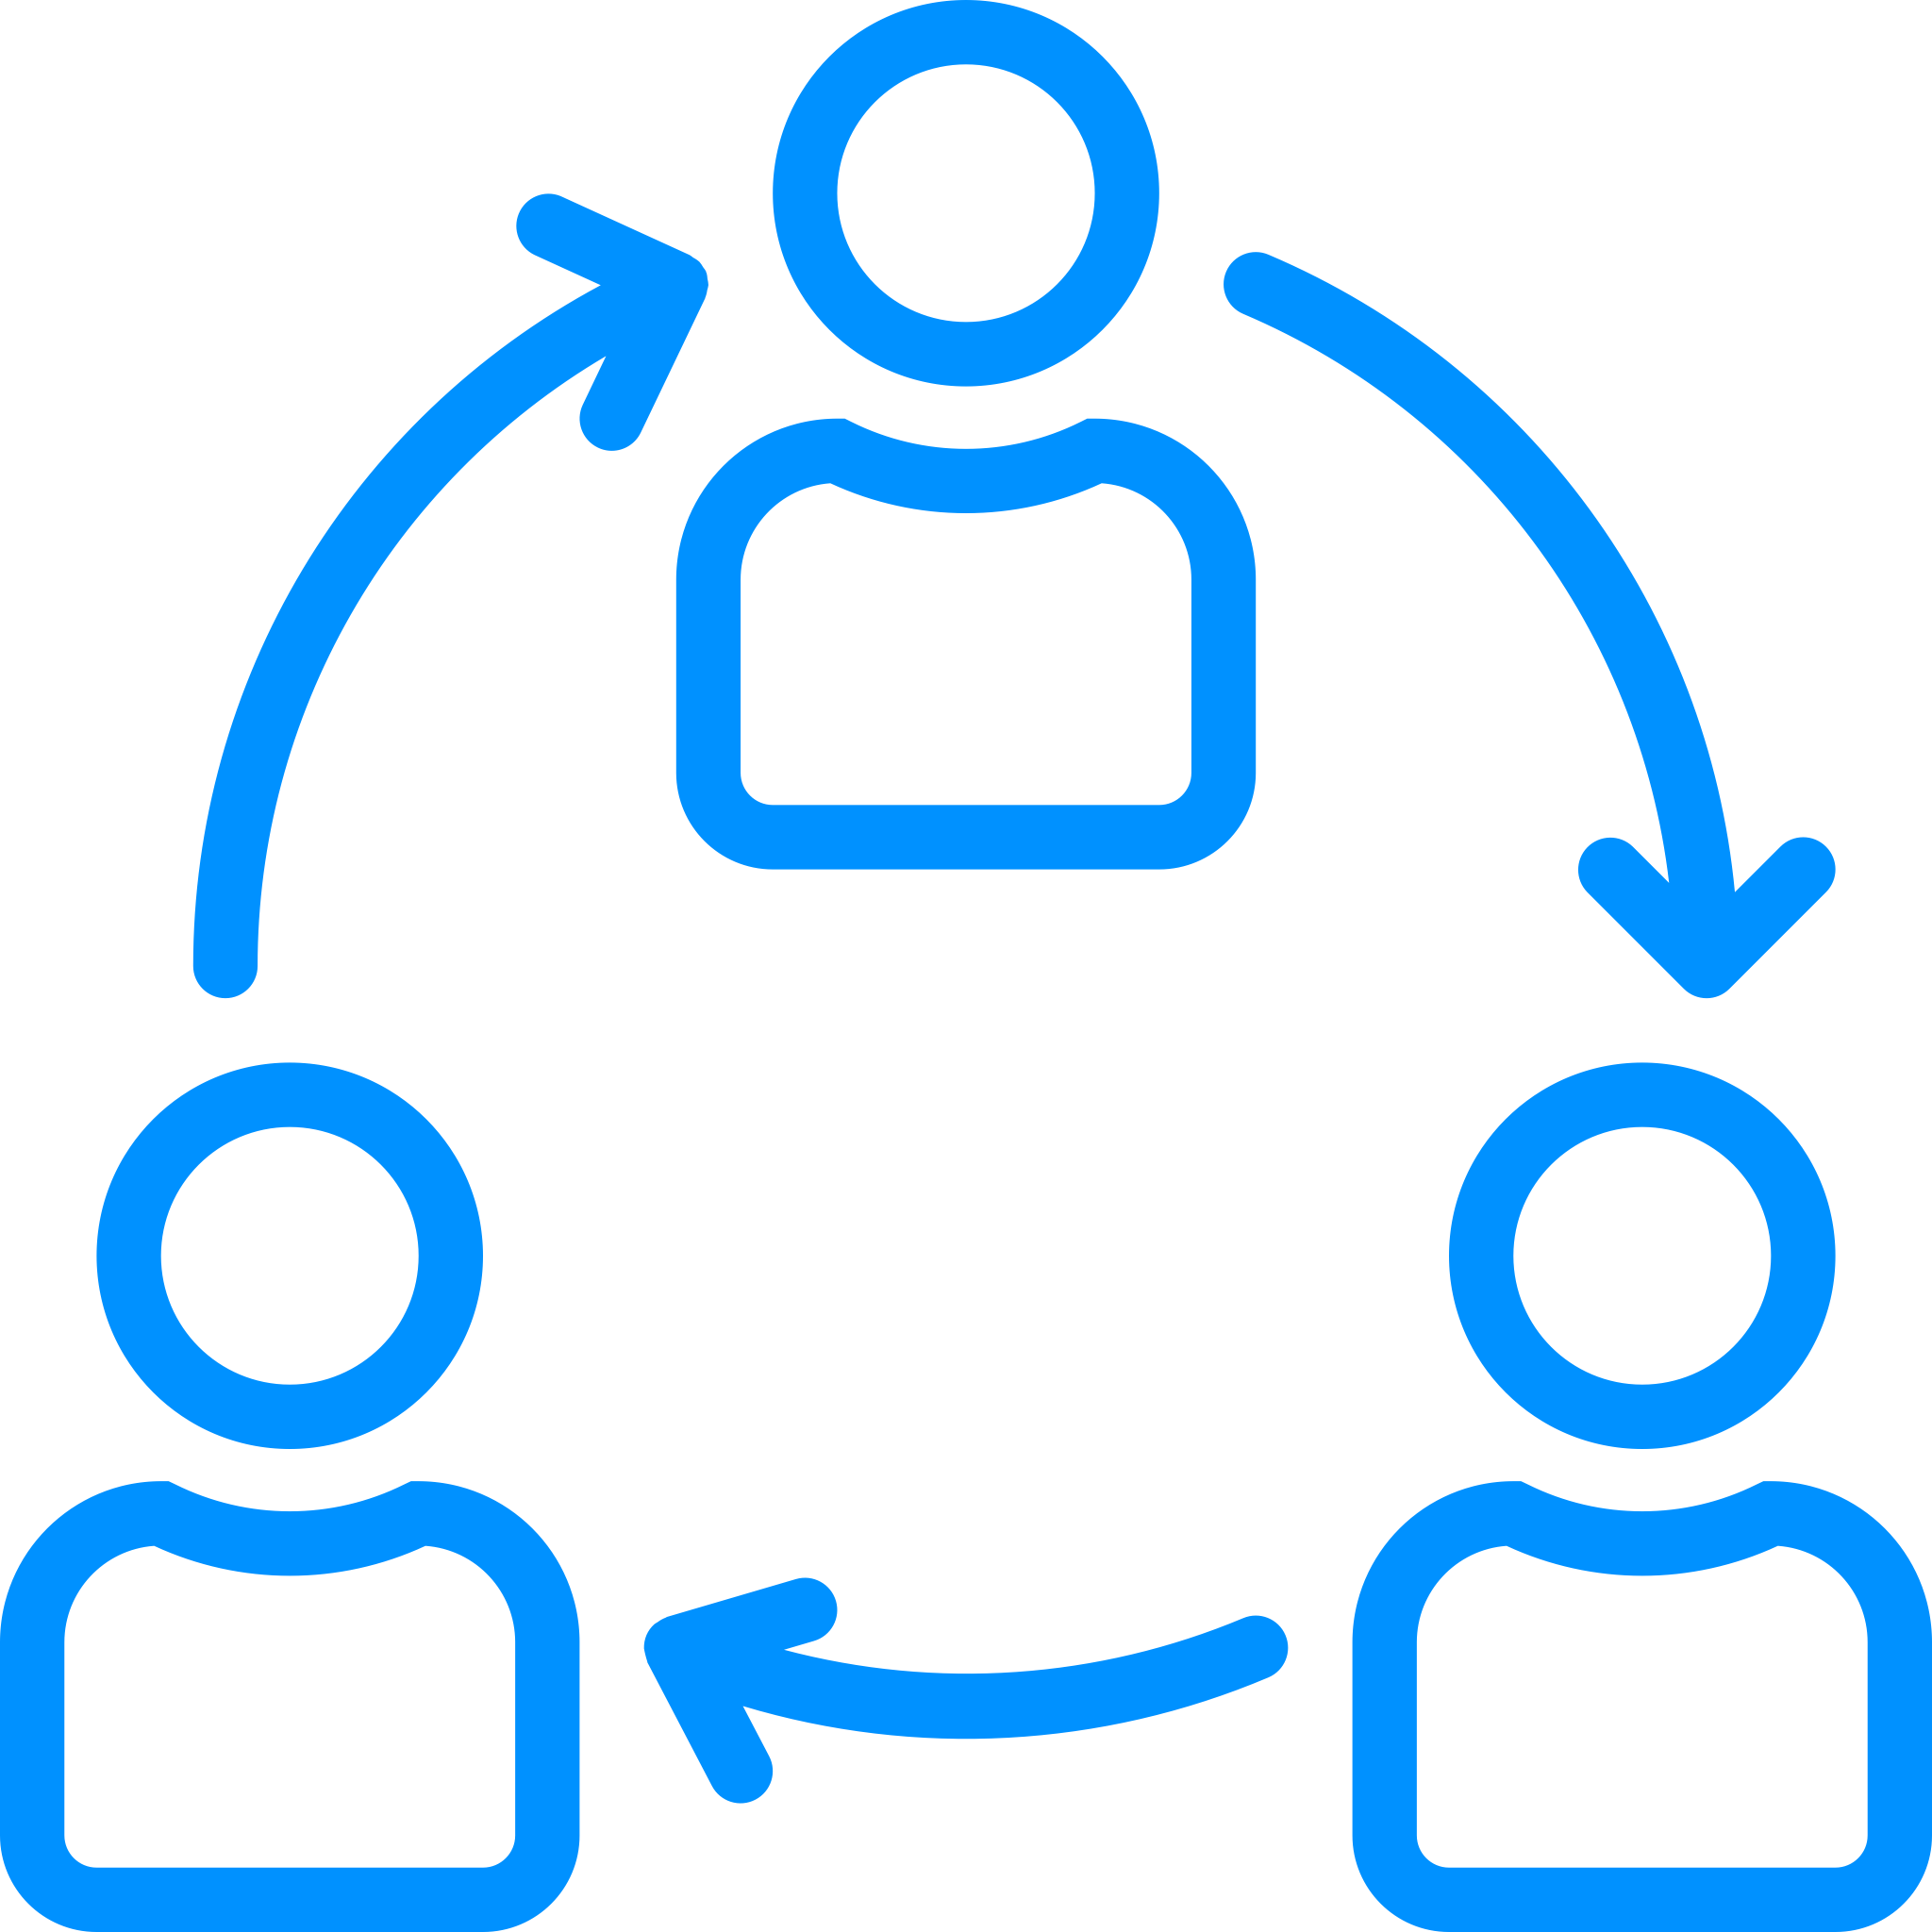
Session Objectives Attendees will be grouped in teams to facilitate collaborative work. Multiple lectures regarding problem determination and troubleshooting will be presented. Following most lectures will be hands-on work that each team collaborates to complete. Review solutions after each lab.

Slide 3
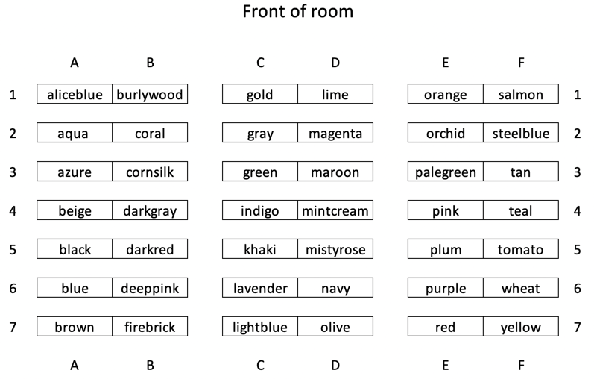
Teams

Slide 4
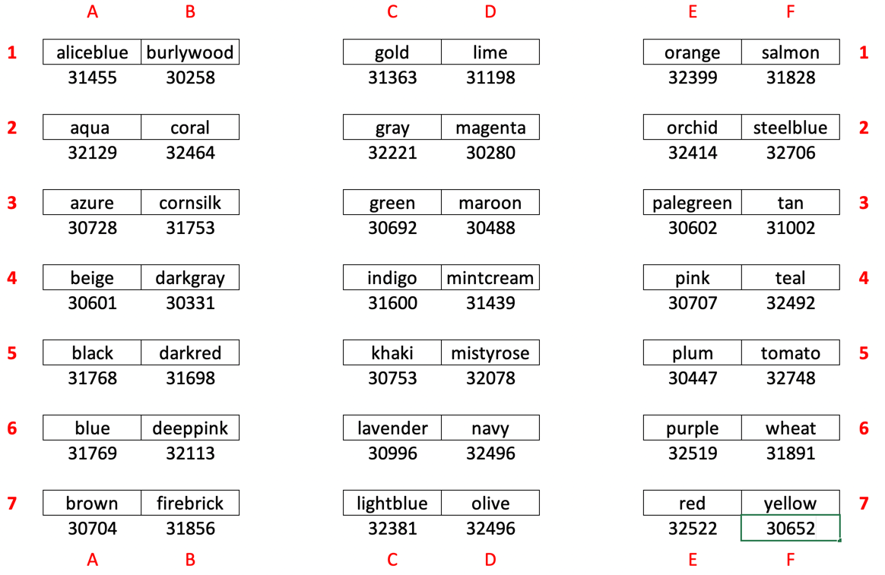
Teams

Slide 5
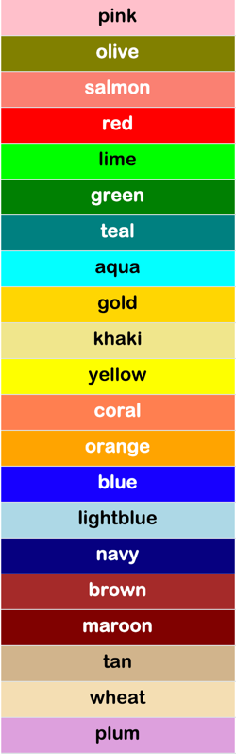
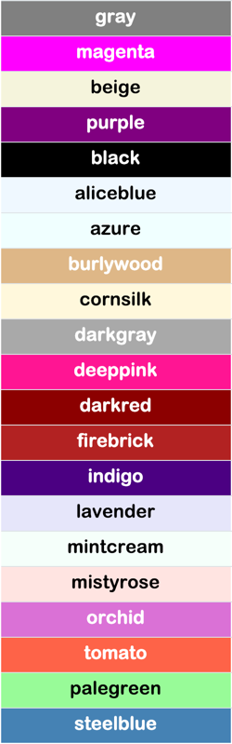
Team Colors
Not in alphabetic
order
Not in alphabetic
order

Slide 6
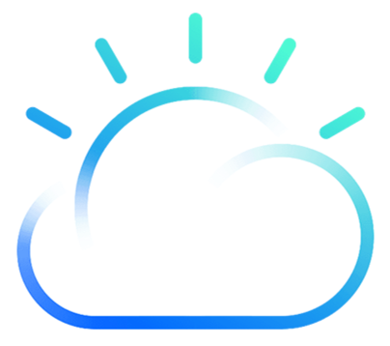
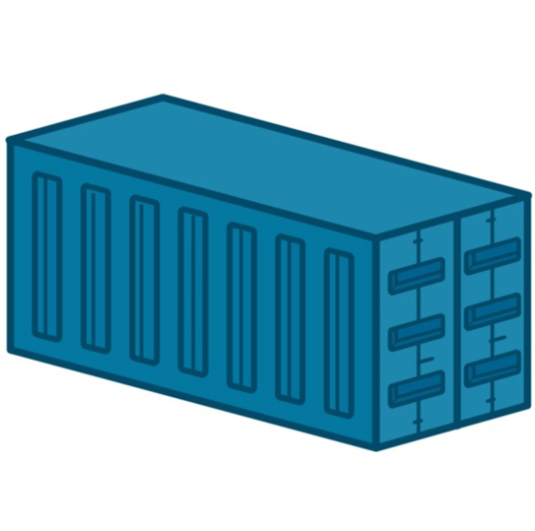
Categories
Container based apps
IBM Cloud Private
Kubernetes
Focus will be on these three categories

Slide 7
Lecture
Tools

Slide 8

Tools in “YOUR” tool kit
We need tools that give us
answers to our questions!

Slide 9
Tools to be used
cloudctl
docker
kubectl

Slide 10
Lab
Installing Tools

Slide 11
Teams

Slide 12

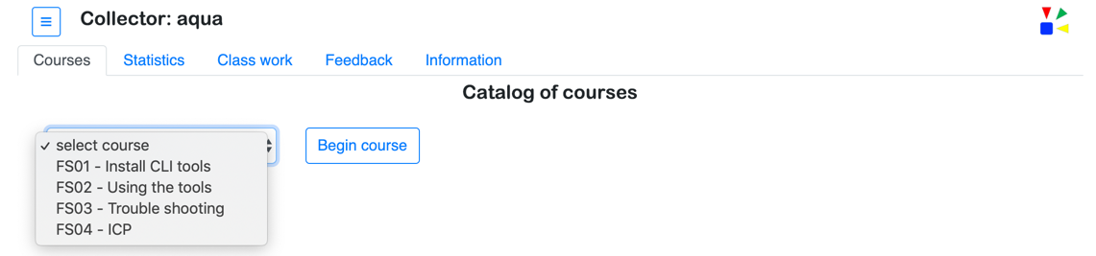
Collector - Accessing team web site
http://120.88.200.115:{port#}
Team name / color will be shown
Select course and press button to begin
Current course catalog

Slide 13
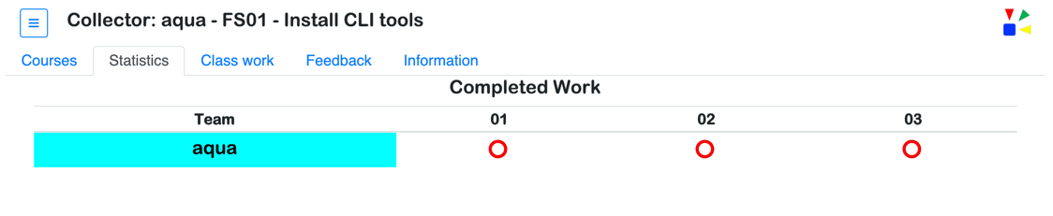
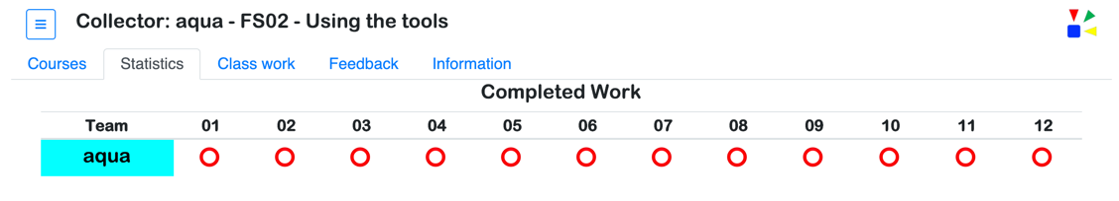
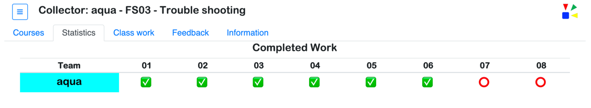
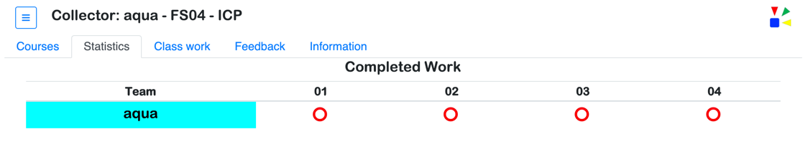
Collector – Track course completed work
Course title
The number of items tracked will change based on the current course selected.
Green checkmark - item is completed
Red circle - item is waiting to be completed

Slide 14
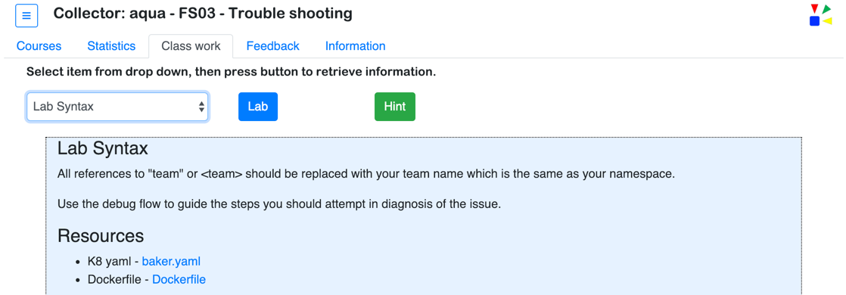
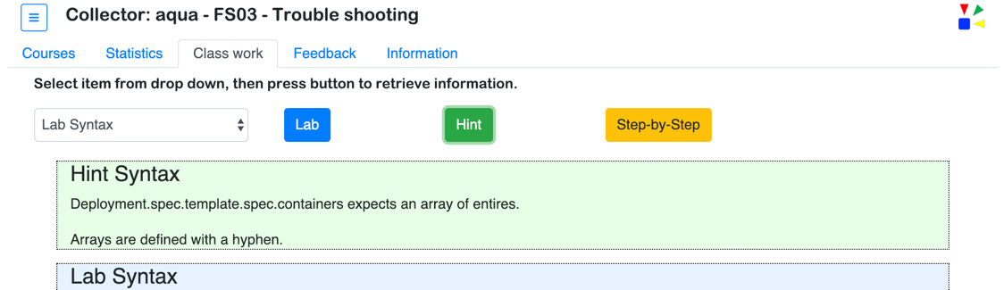
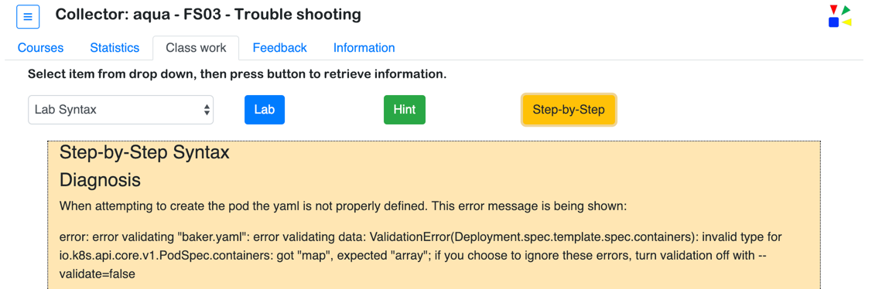
Collector – Class work
Select class work and the blue portion of the screen is shown
Press the green Hint button to show the work hint.
Buttons are not shown all at once. The green and yellow buttons will appear over a period of seconds.
Press the yellow Step-by-Step button to show the detailed steps to complete the work.

Slide 15
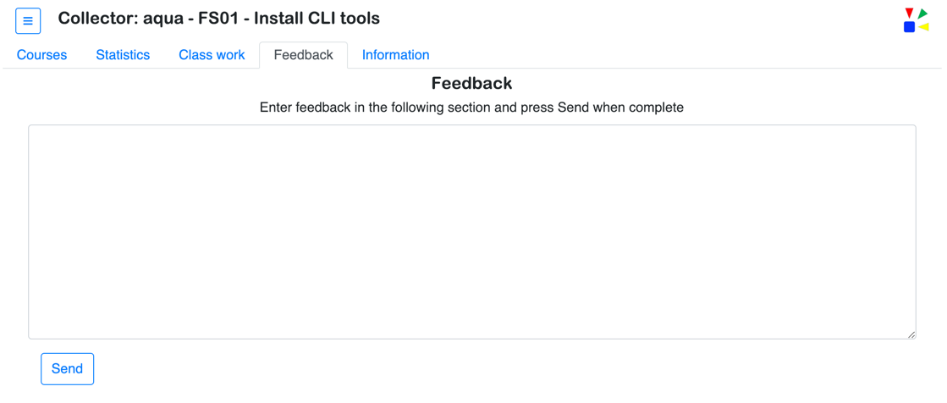
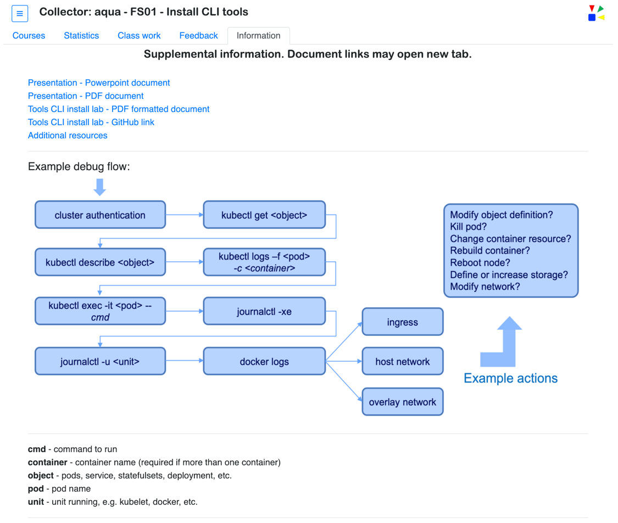
Collector
Please provide your feedback
Additional and helpful information

Slide 16
Lecture
The “Stack”
&
Kubernetes

Slide 17
Application
Container
Understand the
“stack”
K8 object (pod, deployment, service, etc.)
Container runtime (Docker, Rocket, etc.)
Kubernetes
Network (host, overlay, etc.)
Operating System (Red Hat, Ubuntu, etc.)
Hypervisor (VMWare, Nutanix, etc.)
Hardware (x86, Power, Z)

Slide 18
Components that make up a Kubernetes cluster
Master Components
Node Components
etcd
kube-apiserver
kubelet
kube-proxy
kube-scheduler
kube-controller-manger
container
runtime
Addon Components
IBM Cloud Private
IBM Cloud / © 2019 IBM Corporation

Slide 19
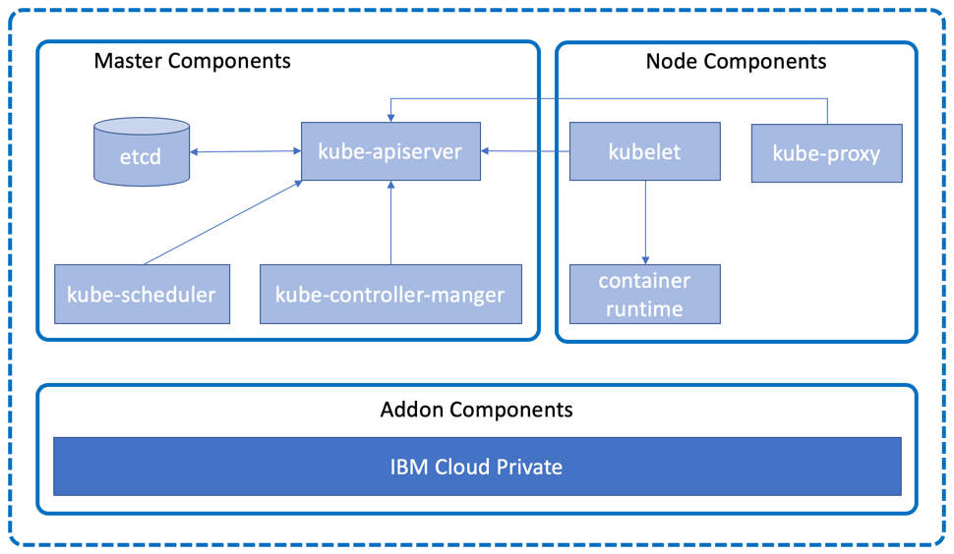
Talking to a cluster
Interact with the cluster through the kubectl command line interface (CLI), which issues REST requests to the Kubernetes kube-apiserver running on the master node.
Local Machine
kubectl

Slide 20
Demo
the Tools

Slide 21
Tools - docker
docker history <image> [--no-trunc ]
docker inspect <image>
docker events (example below grabs a time range)
dstart=$(date "+%Y-%m-%dT%H:%M:%S")
docker run ibmcom/icp-inception:3.1.1
dstop=$(date "+%Y-%m-%dT%H:%M:%S")
docker events --since $dstart --until $dstop
docker run --rm -it --entrypoint=/bin/bash ibmcom/icp-inception:3.1.1
docker stats (will run on a system with multiple containers deployed)

Slide 22
Tools - kubectl
kubectl top [node | pod]
kubectl –n <namespace> get <k8 type>
kubectl –n <namespace> describe <k8 type> <k8 object id>
kubectl –n <namespace> logs [-f] <k8 pod name>
kubectl –n <namespace> exec -it <k8 pod name> [-c <container name>] -- <cmd>
kubectl edit <K8 obj type>/<name>
KUBE_EDITOR="nano" kubectl edit deployment/<name>

Slide 23
Tools - cloudctl
cloudctl login --skip-ssl-validation
-a <API endpoint> https://119.81.199.117:8443
-u <Username> admin
-p <Password> (secret)
-n <Namespace> <team>
cloudctl login --skip-ssl-validation

Slide 24
Lab
Using the Tools

Slide 25
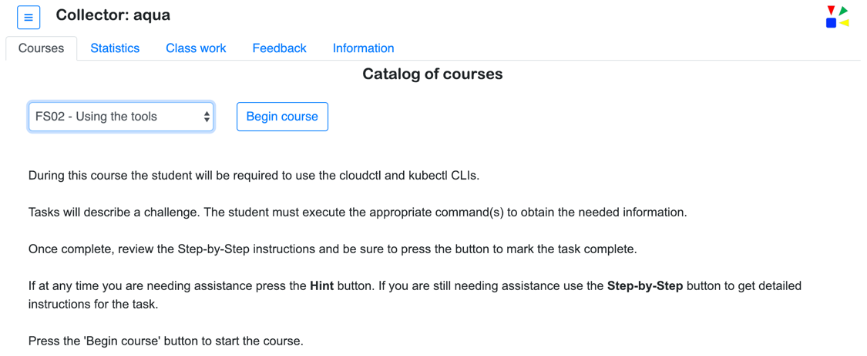
Accessing the course
Collector tracks all list selections and button presses to gather information that is used track, understand, and diagnose lab activities

Slide 26
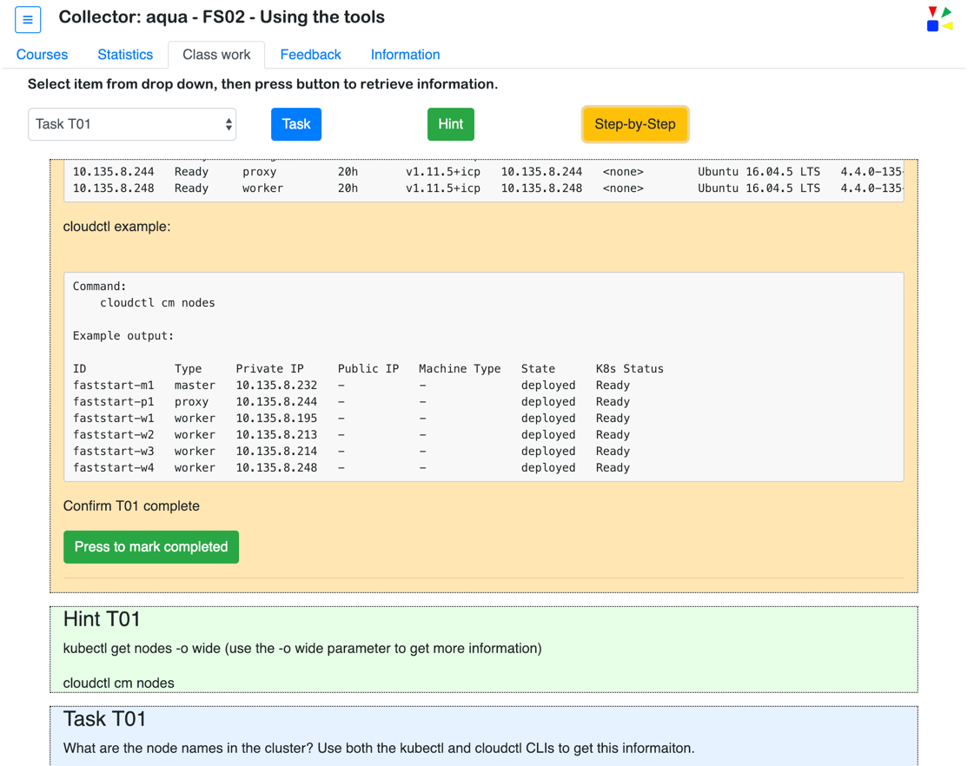
Completing the work
IMPORTANT
Press the button to mark the question as completed

Slide 27
Authenticate session using cloudctl
<Open terminal or shell window>
cloudctl login --skip-ssl-validation
-a <API endpoint> https://119.81.199.117:8443
-u <Username> admin
-p <Password> (secret)
-n <Namespace> <team>
cloudctl login --skip-ssl-validation

Slide 28
Teams working together to answer the Questions

Slide 29
Lecture
Containers
&
Apps

Slide 30
Components of a container based application
Docker
Build
Push
Run
Stop
Inspect
History
Events
CONTAINER
Application
Bins/Libs

Slide 31
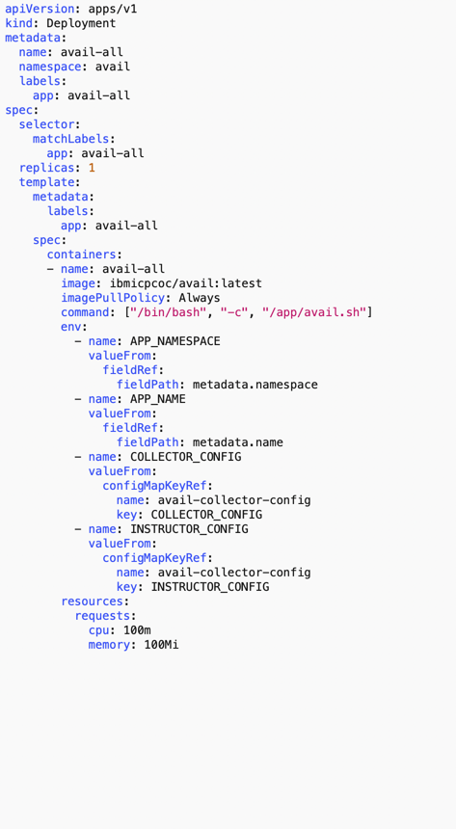
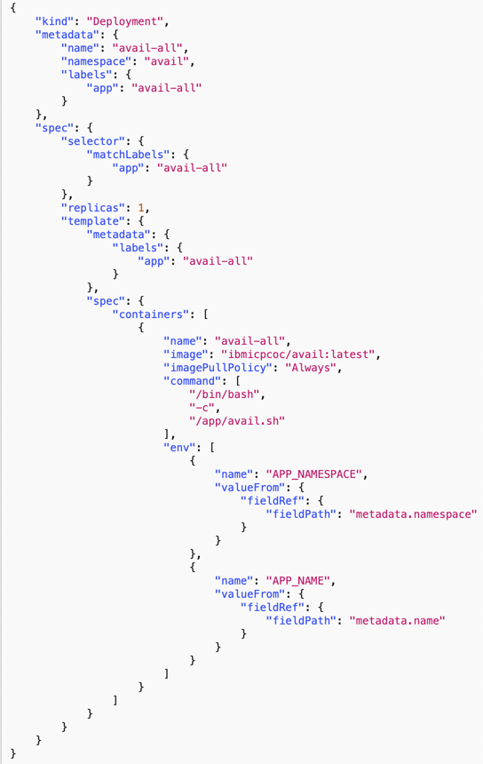
Defining K8 objects
yaml json
Indentation (spaces)
Hyphens
matter
{}
[]
Quotes
Commas
matter

Slide 32
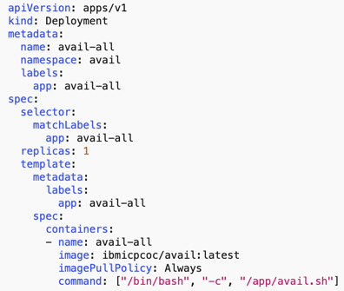
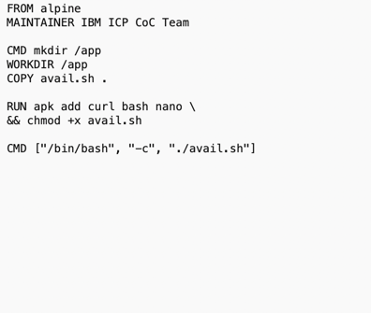
What’s running in the container
k8
docker

Slide 33
Note to the instructor:
ensure 02_avail_fail is deployed

Slide 34
Lab
Fixing
stuff that’s
broken

Slide 35
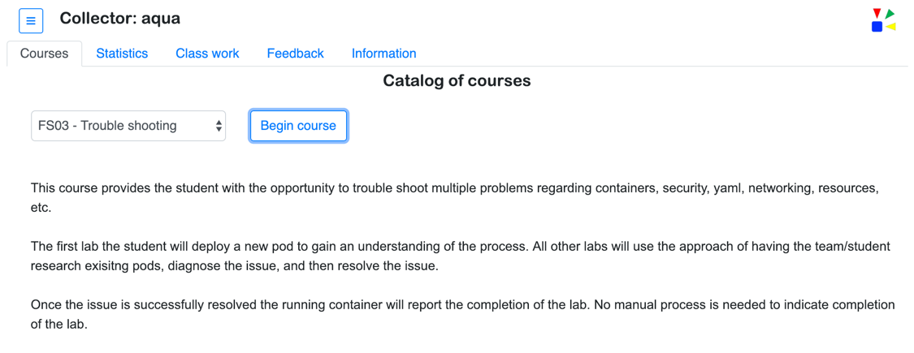
Accessing the Labs

Slide 36
Example debug process
Modify object definition?
Kill pod?
Change container resource?
Rebuild container?
Reboot node?
Define or increase storage?
Modify network?
cluster authentication
kubectl get <object>
kubectl describe <object>
kubectl logs –f <pod>
-c <container>
kubectl exec -it <pod> -- cmd
journalctl -xe
ingress
journalctl -u <unit>
docker logs
host network
<object> - pods, service, statefulsets, deployment, etc.
<pod> - pod name
<container> - container name (required if more than one container)
cmd - command to run
<unit> - unit running, e.g. kubelet, docker, etc.
Example actions
overlay network
IBM Cloud / © 2019 IBM Corporation

Slide 37
Don’t forget to check
Security
Networking
Storage
Images
CPU & Memory

Slide 38
Teams working together to complete the Labs
Did instructor start: 02_avail_fail

Slide 39
Lecture
ICP

Slide 40
Lab – Instructor Lead
Trouble-shoot
ICP

Slide 41
What’s in ICP?
audit*
auth*
calico*
k8*
key-management*
logging*
metering*
monitoring*
Not a complete list

Slide 42
What’s in ICP?
audit*
auth*
calico*
k8*
key-management*
logging*
metering*
monitoring*
Not a complete list

Slide 43
Teams working together to complete
the ICP Labs

Slide 44

Support
Slack #private-cloud
Intended for quick answers through swarming, especially How To, Known Issues, best practices etc.
Cases can be opened at
https://ibm.biz/icpsupport
If you can’t open a case, please see https://ibm.biz/BdYuiZ

Slide 45
Additional Information
Example of logs to collect
https://github.ibm.com/IBMPrivateCloud/support-tools/blob/master/log_collector/icplogcollector-master.sh
VpK and KubeToy
https://github.com/IBM-ICP-CoC/VpK
https://github.com/IBM-ICP-CoC/KubeToy
Dive
https://github.com/wagoodman/dive
50 Useful Kubernetes Tools
https://caylent.com/50-useful-kubernetes-tools/

Slide 46
Thank you

Slide 47

Meetup Information (starter kit & training) http://ibm.biz/meetup-kit http://ibm.biz/meetup-training Recorded Lunch and Learn http://bit.ly/social-lnl DTE Social Handles (on ZACs) http://ibm.biz/dte-social IBM Cloud Social Handles http://ibm.biz/cloud-social DTE Blog Calendar http://ibm.biz/blog-calendar Social Selling Badges https://ibm.co/2yGFm00
Learn more about your IBM Community & Social Selling
Social Tips & Tricks Videos (pinned in #dte-social Slack channel) https://bit.ly/linked-profile https://bit.ly/linked-headline http://bit.ly/link-communities Community Videos (pinned in #IBMCommunity Slack channel) http://ibm.biz/community-intro http://ibm.biz/community-groups http://ibm.biz/community-notification

